Slide 1
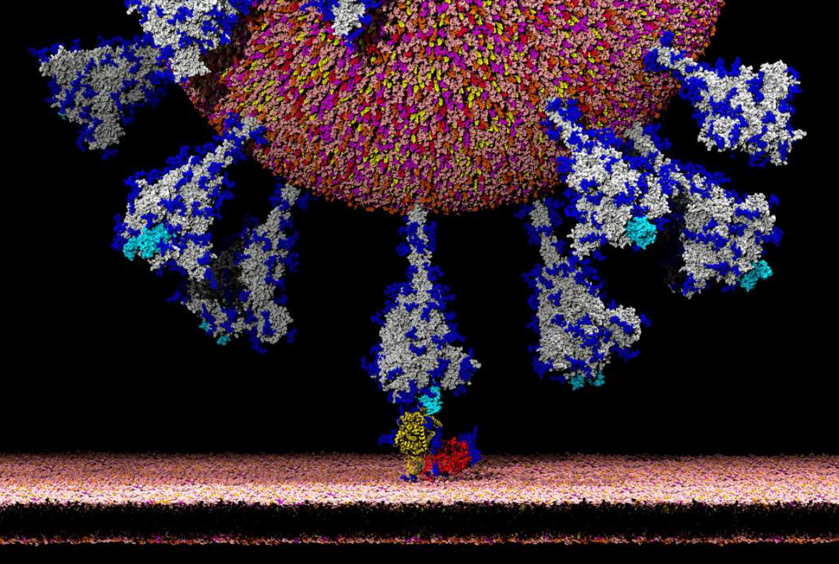

Equalities Reps Conference
Rob Miguel National H&S Officer

Slide 2
Summary Work-related Stress, depression or anxiety in Great Britain
828,000
Workers suffering from work-related stress, depression or anxiety
17.9 million
Working days lost due to work-related stress, depression or anxiety
Mental distress was 8.1% higher in 2020 than between 2017/19
10% more needed treatment
31.2% of women and
17.7% of men reported anxiety
28.5% of women and 16.7% of men
Reported Depression

Slide 3
Worker Assistance Programme Triage System
Disability Issues
Domestic violence
Prejudice
Childcare issues

Slide 4
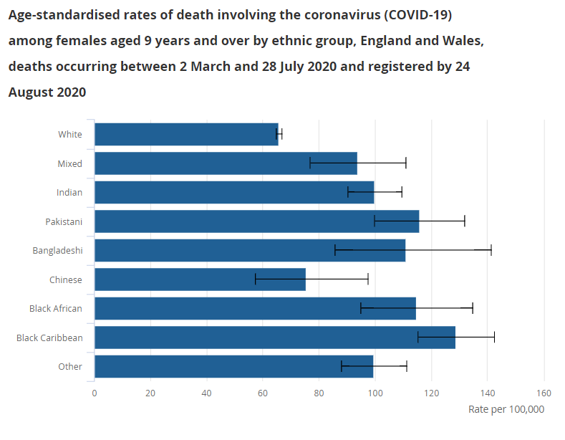
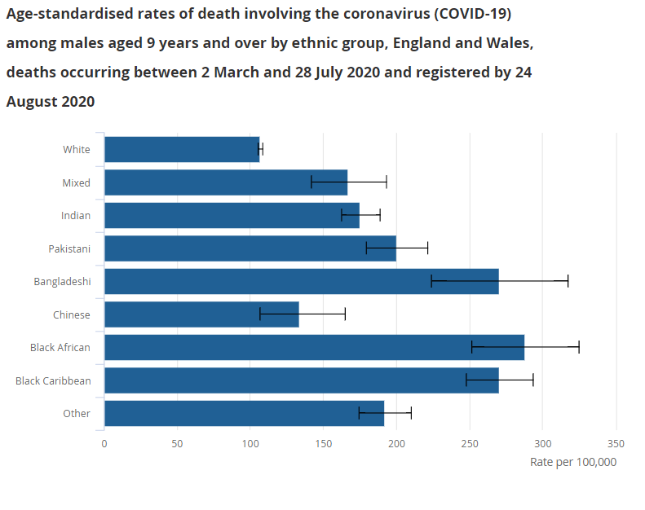
Women
Men

Slide 5
Risk factor | Score
Age – Covid-19 seems to have a bigger impact on people who are older.
If you are aged between 50-59 | 1
If you are aged between 60-69 If you are aged 70-79 | 2 4
Sex at birth – Covid-19 seems to have a bigger impact on males than females
Male | 1
Ethnicity – Covid-19 seems to have a bigger impact on people from some ethnicities
BAEM or mixed race groups, Scores will differ depending on specific race and various tools will to allocate figures accordingly.
Existing Health conditions (Comorbidity) – Covid-19 seems to have a bigger impact if you already have other pre-existing health conditions. You may want to speak to your GP if you are not sure about these questions.
Cardiovascular disease Are you on any treatment for Hypertension (high blood pressure), Atrial Fibrillation (Irregular heart rate), Heart Failure, Previous MI (had a heart attack), had a stroke, or Transient Ischemic Attack (mini stroke) | 1
Diabetes Mellitus Type 1 or 2 | 1
Chronic lung disease (including asthma, COPD, interstitial lung disease) | 1
Chronic kidney disease (any stage 1-5) | 1
Sickle cell trait, Thalassaemia trait or other haemoglobinopathy | 1
Obesity – Covid-19 seems to have a bigger impact if you are overweight
BMI of approximately 30 This link will help you work out your BMI – if your BMI is more than 30 | 1
Total
Low Risk 0-3 | High Risk 4-6 | Very High Risk 7 or more
Continue with caution | Consider modified duties and PPE Review | Work from home or non patient facing

Slide 6
Some assessments used to discriminate
Female sex -5
Asian or Asian British 5 Black 7 Mixed 5 Other non-white 4
Asthma: Mild 1 Severe 15
BM1 30/35 7
Diabetes type 1 24
A healthy white woman, aged 40, has a Covid-age of (40-5) = 35 years
A white man aged 45, BMI 32 with severe asthma, has a Covid-age of (45+7+15) = 67 years.
An Asian woman aged 50 with Type 1 diabetes, Covid-age of (50-5+24) = 69

Slide 7
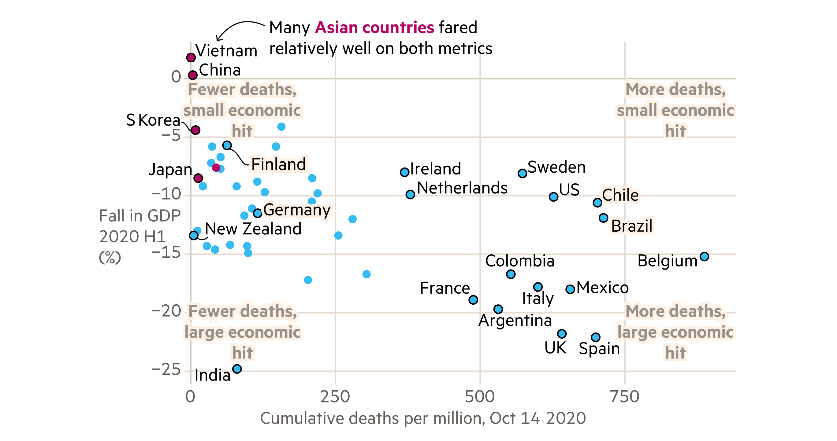

Slide 8

Health & Safety guidance on coronavirus/Covid-19 for officers and reps [PDF].
Unite advice on risk assessments/procedures [PDF].
Unite test and trace guide [PDF]
Covid-19: Unite guide to workplace equality impact assessments [PDF]
Reps guide & checklist: Extremely vulnerable groups and return to work [PDF]
Mobile phones and Covid-19 advice [PDF]
Unite social distancing policy [PDF]
BAEM Covid-19 health and safety guide [PDF]
Advice on your legal right to a safe place of work [PDF]
Workplace infection controls & facilities [PDF]
Home working [PDF],
Mental Health Under the Strain of A Pandemic [PDF]

